Slide 1
Warm UP
Nothing to write down.
You have 7 minutes to study

Slide 2
Wednesday
Accelerated Science 1 Grade 6
September
Today’s Agenda
Warm up
Test
Achieve When the Sky Turned Red and Green Respond and Write only
Homework
Make up due next class
9
Reminders/Homework
No items Edit
____________________________________________
_______________
_______________
_______________
_______________
_______________
_______________
_______________
_______________
_______________
_______________
_______________
_______________
_______________
Make up Baseline Testing
SC.8.P.8.3
Notes:
https://onedrive.live.com/view.aspx?resid=CB874CC0C44B1C9F!979197&ithint=file%2cpptx&authkey=!ALEdFdOPfacslVk

Slide 3
Upcoming
Monday Sept 12 Open House 6-7:30 pm
Tuesday Sept 13 FAST Testing Reading Adjusted Schedule
Assigned testing rooms
Wednesday Sept 14 FAST Testing Math Adjusted Schedule
Same assigned testing rooms

Slide 4
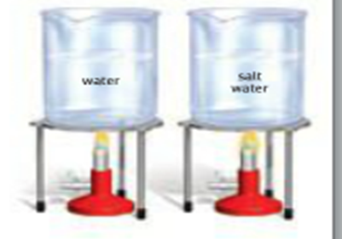
After test….. Blended Learning>Achieve 3000 Achieve Article When the Sky Turned Red and Green Respond and Write only
Water
Salt Water
Flame from Bunsen Burner

