Slide 1
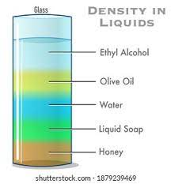
Warm UP (from the homework)
Which is most dense? Which is least dense?
Practice Problems
Density is ________________
Mass is 20 KG
Volume is 5 L
2. Density is ________________
Mass is 50 KG
Volume is 150 L
3. Density is ________________
Mass is 350 KG
Volume is 50 L
4. Density is ________________
Mass is 45 KG
Volume is 9 L
5. Density is ________________
Mass is 75 KG
Volume is 15 L

Slide 2
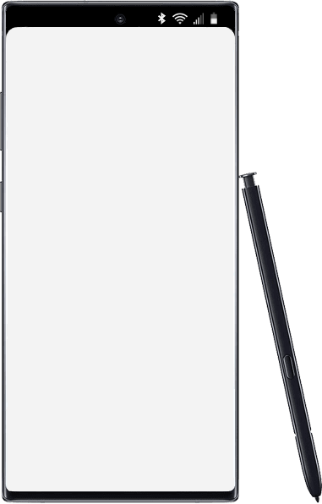
Wednesday
Accelerated Science 1 Grade 6
September
Today’s Agenda
Warm up
Review Focus/Upload
Return sub work
Online Review
Study Guide
Homework
Test next class
7
Reminders/Homework
No items Edit
____________________________________________
_______________
_______________
_______________
_______________
_______________
_______________
_______________
_______________
_______________
_______________
_______________
_______________
_______________
Make up Baseline Testing
SC.8.P.8.3
Notes:
https://onedrive.live.com/view.aspx?resid=CB874CC0C44B1C9F!979197&ithint=file%2cpptx&authkey=!ALEdFdOPfacslVk

Slide 3
Go to Focus
If you have an NG with a note…..read the note
If it is a blank document
Go to One Drive
Download
Then upload to Focus

Slide 4
Kahoot.it
Log on
Create a school appropriate nick name with your name in it.
Top three winner get bonus point on test
Battle of the Blocks Top class points- entire class gets bonus points

Slide 5
Classwork/Homework
Study Guide Due next class (Focus)
Finish sub work (if needed-due next class)

