Slide 1
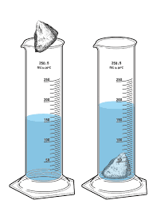
Warm up (DNB warmup)
What is the volume of this rock?
Starting volume 115mL
Ending volume 118mL

Slide 2
Make up Pretest
Deskins
McBeath
Moen
Soto
Tudor
Whetsel

Slide 3
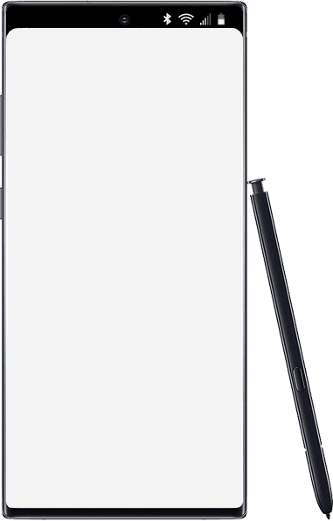
Thursday
Accelerated Science 1 Grade 6
August
Today’s Agenda
Warm up
Technology Tips
WS: Density Review (Focus due 9/2
31
Reminders/Homework
No items Edit
____________________________________________
_______________
_______________
_______________
_______________
_______________
_______________
_______________
_______________
_______________
_______________
_______________
_______________
_______________
Make up Baseline Testing
SC.8.P.8.3
Notes:
https://onedrive.live.com/view.aspx?resid=CB874CC0C44B1C9F!979197&ithint=file%2cpptx&authkey=!ALEdFdOPfacslVk

Slide 4
Today’s Benchmark
SC.8.P.8.3
Explore and describe the densities of various materials through measurement of their masses and volumes.

Slide 5
Upload to Focus

Slide 6
www.mrsnanneyscience.weebly.com

Slide 8
Online Textbook Blended Learning?>Mcgraw Hill

Slide 9
6th grade Book

Slide 10
8th grade book

Slide 11
DNB Digital Notebook in One View

Slide 12
Writing a teacher email/checking email
Student email snumber@students.duvalschools.org
Subject line: short to the point EX Missing work
Body of email:
Greeting EX Good Morning,
State your request: EX I was absent on Friday. I looked on your website and am confused.
Thank you
First and Last name

Slide 13
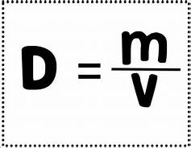
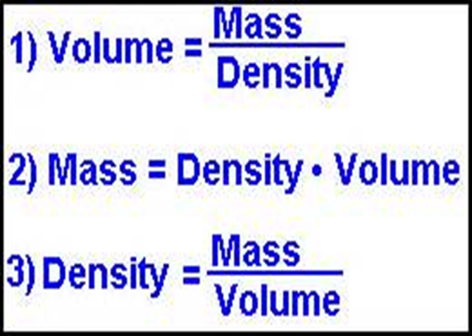
Density Review

Slide 15
Classwork/Homework WS Intro to Density (Focus due 9.2)

