Slide 1
Warm up (DNB in laptop)
Which box has more density?
Which box is less dense?

Slide 2
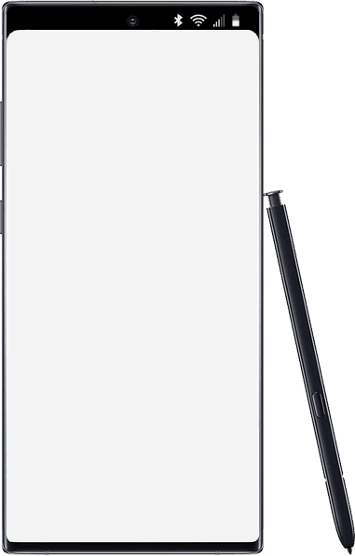
Thursday
Accelerated Science 1 Grade 6
August
Today’s Agenda
Warm up
Collect text pages
Cnotes: Density (DNB Classnotes)
Lab: Density
29
Reminders/Homework
No items Edit
____________________________________________
_______________
_______________
_______________
_______________
_______________
_______________
_______________
_______________
_______________
_______________
_______________
_______________
_______________
Make up Baseline Testing
SC.8.P.8.3
Notes:
https://onedrive.live.com/view.aspx?resid=CB874CC0C44B1C9F!979197&ithint=file%2cpptx&authkey=!ALEdFdOPfacslVk

Slide 3
Finish or MakeUP Pretest Now
Sarah B
Dalia B
Breon C
Madilyn D
William D.
Colby G
Braedon M
Janai M
Mason M
Harry P
Abel S
Jahzara T
Jamyra W
Kaleb W

Slide 4
Early Dismissal This Wednesday
School ends at 1:10
Lunch at 9:45

Slide 5
Today’s Benchmark
SC.8.P.8.3
Explore and describe the densities of various materials through measurement of their masses and volumes.

Slide 6
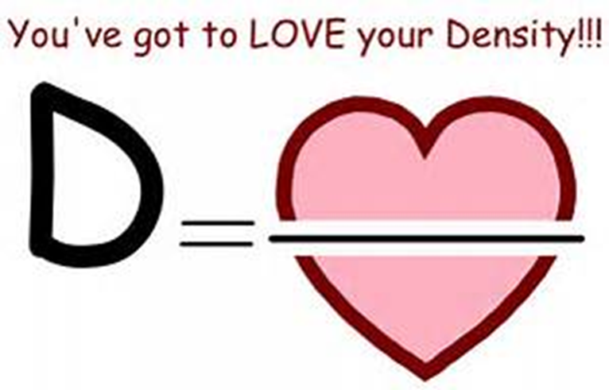
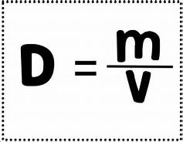
Cnotes: Density
What is density?
It measures how closely packed the molecules are in a given space.
Density is the ratio of mass to volume.

Slide 7
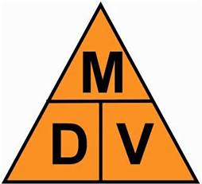
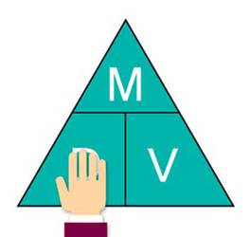
Density Formulas

Slide 8
Density Practice 1
A platinum bar measures 5.0 cm. long, 4.0 cm. wide and 1.5 cm. thick. It has a mass of 700.0 grams.
Calculate the volume of the platinum bar.
Calculate the density of the platinum bar.

Slide 9
Density Practice 2
A teacher performing a demonstration finds that a piece of cork displaces 23.5 mL of water. The piece of cork has a mass of 5.7 g. What is the density of the cork?

Slide 10
Lab Density
4 Material Manager Makes sure material available marble
3 Data Recorder Calculations are correct dice
2 Timekeeper Makes sure lab is finished silver cylinder
1 Lab Manager Makes sure that procedures are followed brass cylinder

Slide 11
Density Station
Materials: Marble, brass cylinder, silver cylinder, large cylinder, dice
Graduated cylinder and ruler.
Calculate the density of each of the items.
Item | Mass (g) | Volume (cm³ | Density (g/cm³⁾
Marble
Brass Cylinder
Silver Cylinder
Large Cylinder
Dice

Slide 12
Homework
Complete Lab including Analyze and Conclude Questions. Upload to Focus

