Slide 1
Get Ready If you do not have a laptop let me know
Go to DNB (Digital Notebook) found in One Note
Go to tab quarter 1 warmup
Complete warmup

Slide 2
Warm UP
Why do scientists need to control their experiments?
What should you do if you break glass in this class?
What should you do if you spill liquids in this class?
Should you touch the equipment on the counters if Mrs. Nanney is not in the room?

Slide 3
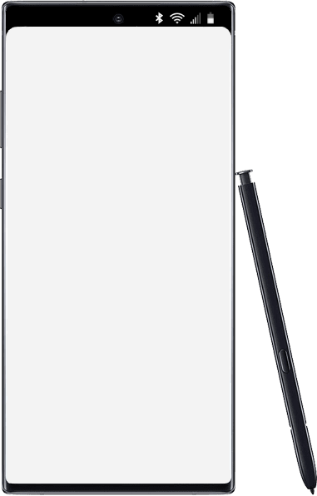
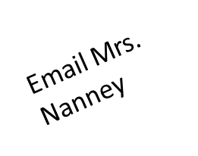
Thursday
Today’s Agenda
Warm up
Cnotes Variable (DNB Classnotes) or on paper
Station Rotations Minion Variables (DNB)
WS Variables (paper)
Accelerated Science 1 Grade
August
23
Reminders/Homework
No items Edit
____________________________________________
_______________
_______________
_______________
_______________
_______________
_______________
_______________
_______________
_______________
_______________
_______________
_______________
_______________
Pretest next class
SC.6.N.1.1
Notes:
https://onedrive.live.com/view.aspx?resid=CB874CC0C44B1C9F!979197&ithint=file%2cpptx&authkey=!ALEdFdOPfacslVk

Slide 4
Cnotes: Variables
Independent Variable
Dependent Variable
Constants
I changed on purpose
Data collected
Parts that all are the same

Slide 5
o

Slide 6
Station Rotations Variables
Three station rotations all with the same questions.
Answer in your DNB under Handouts

Slide 7
Classwork/Homework
Check WS Sponge Bob Variables
Complete all missing work
Make sure that there are no blank pages in Focus
WS Identifying Variables

