Slide 1
Get Ready
Take out Signed Safety Contract
Take out 1 sheet of paper

Slide 2
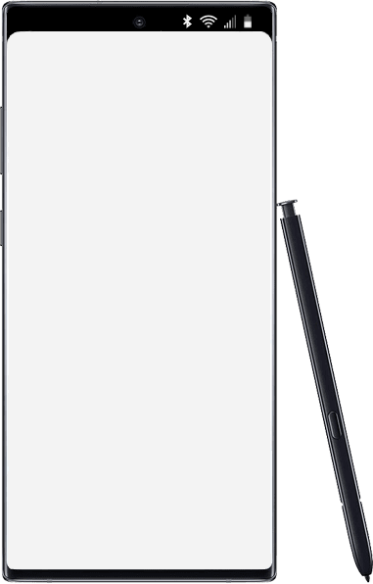
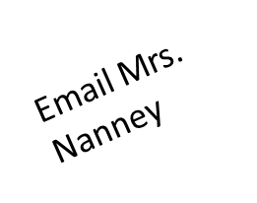
Thursday
Today’s Agenda
Warm up
Turn in Safety
Lab Bubble Pop
Accelerated Science 1 Grade 6
August
19
Reminders/Homework
No items Edit
____________________________________________
_______________
_______________
_______________
_______________
_______________
_______________
_______________
_______________
_______________
_______________
_______________
_______________
_______________
Two Assignments should be turned in.
SC.6.N.1.1
Notes:
https://onedrive.live.com/view.aspx?resid=CB874CC0C44B1C9F!979197&ithint=file%2cpptx&authkey=!ALEdFdOPfacslVk

Slide 3
Warm UP (Write the answers only the sheet of notebook paper from previous class)
In science measurements are taken using the metric system.
Fill in the blanks:
To measure length of your finger, you use a ___________. The units are centimeters.
To measure the volume of a cube, you use the formula:
______________ times_________ times___________
To find the mass of a book, you use a ____________ measured in grams.

Slide 4
Get Ready
Take out homework…. signed Safety Contract.
Returned safety contract LAST LAB IF CONTRACT NOT SIGNED
Get goggles and apron.

Slide 5
Lab: Bubble Pop
Write everything on the notebook paper.

Slide 6
Copy this down
Testable Question: Which solution makes the largest bubble?

Slide 7
Hypothesis Copy first highlighted sentence down and fill in the blank
If the bubble solution is ___________, then it will create the largest bubble.
Choices for blank:
Solution A Store-bought bubble solution
Solution B Dishwashing Detergent
Solution C Dishwashing Detergent plus 10mL glycerin
Solution D Dishwashing Detergent plus 20mL glycerin

Slide 8
Lab Roles
Materials Manager Seat 1 Manages material/Cleans up Solution A
Data Recorder Seat 2 Writes down data for everyone to copy Solution B
Data Collector Seat 3 Takes measurements/tells data recorder Solution C
Lab Manager Seat 4 Makes sure lab runs smoothly/timer Solution D

Slide 9
Materials
Straws, 4 solutions, rulers, pipettes

Slide 10
Procedure
Each lab group will have a container of each solution.
Assign each person one solution.
Moisten area with a drop or two of water.
Add one drop of solution.
Hold the straw perpendicular, gently blow a bubble.
Measure print left by bubble.
Record data
Repeat each solution 3 times.

Slide 11
Data Table Copy this down
Type of Solution | Trial 1 Diameter (cm) | Trial 2 Diameter (cm) | Trial 3 Diameter (cm) | Average
Solution A
Solution B
Solution C
Solution D

Slide 12
Safety
Don’t mix up the pipettes.
Don’t suck up the solution.

Slide 13
Analyze and Conclude
Was your hypothesis correct or incorrect?
Why is it “okay” if your hypothesis was incorrect?
What is something to change in this experiment if you were going to do it again?
Why was the data repeated three times?

Slide 14
Exit Ticket
Make sure that your area is cleaned.

