Slide 1
Get ready for the day Same seats as Monday
Take out three sheets of paper
Fold one sheet into fourths
Period 1 Assembly

Slide 2
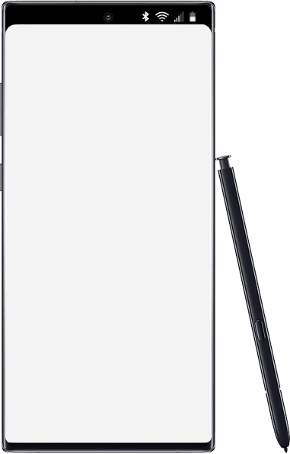
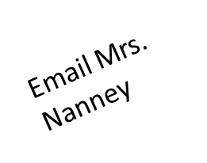
Thursday
Today’s Agenda
Warm up
Turn in WS Crazy Classroom
Video: Safety with notes
Visit class website
www.mrsnanneyscience.weebly.com
4. Explain textbooks
5. Homework time
Accelerated Science 1 Grade 6
August
17
Reminders/Homework
No items Edit
____________________________________________
_______________
_______________
_______________
_______________
_______________
_______________
_______________
_______________
_______________
_______________
_______________
_______________
_______________
WS: Minions Loose in the Lab
SC.6.N.1.1
Notes:
https://onedrive.live.com/view.aspx?resid=CB874CC0C44B1C9F!979197&ithint=file%2cpptx&authkey=!ALEdFdOPfacslVk

Slide 3
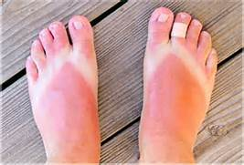
Warm UP Take out a sheet of paper divide into 4 sections.
In section one answer this question:
What is the difference between an observation, inference, and prediction? Use the picture to explain your answer.

Slide 4
On the second sheet of paper Title: Video Notes Safety
Write down the 10 lab safety rules shown in the video. I will pause the video.

Slide 6
Safety Contract
Signed and returned next class.

Slide 7
Mrs. Nanney’s website www.mrsnanneyscience.weebly.com

Slide 8
Scroll down…..

Slide 10
Textbooks You will get two textbooks. They will be left in class. We will tear out the pages we need. Also online textbooks under Blended Learning.

Slide 11
Classwork:
Start on WS: Minions Loose in the Lab

Slide 12
Homework
Complete Worksheet
Bring signed Safety Contract

